Slide 1
Finding articles quickly:
Teaching tips
Teaching Evidence Based Medicine
3rd September 2012
Nia Wyn Roberts & Owen Coxall
Bodleian Health Care Libraries

Slide 2

This is NOT a searching workshop

Slide 3

Finding information about Oxford

Slide 4
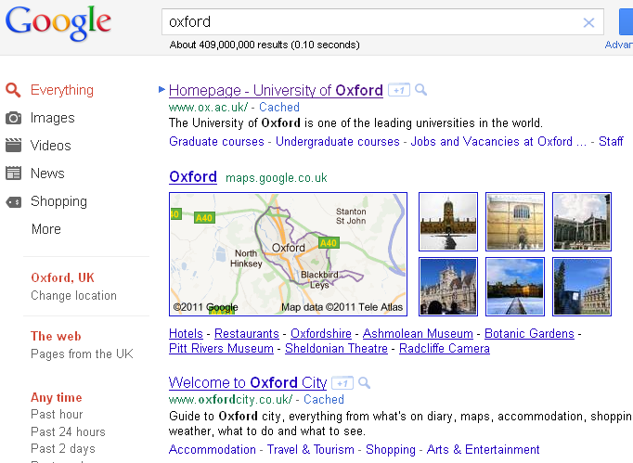




Slide 5
Why do this?
Starts off with a question everyone can answer?
  Non-threatening, encourages people to participate
Learning point
  Illustrates there are lots of different sources of information
Other examples
  Going on holiday, buying a car, getting a new pet…

Slide 6
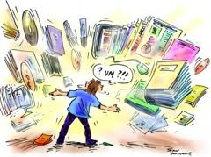
Finding clinical information

Slide 7
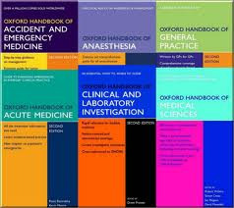




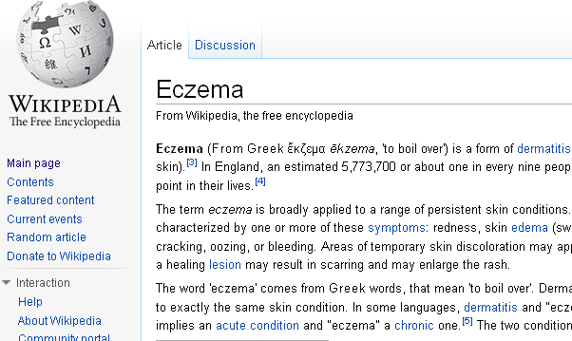


Slide 8
Why do this?
Gives you an idea of their current knowledge?
Gives an indication of the variety of resources available
Gives an opportunity to point out the pros / cons of different resources
If no one mentions Google – you need to work harder

Slide 9
Clinical scenario
Real clinical cases
  From clinical rounds / consultations
  Journal clubs
  Online video clips
News stories
  Newspapers, news web-sites
  Blogs
  Journal web-sites – In the news

Slide 10
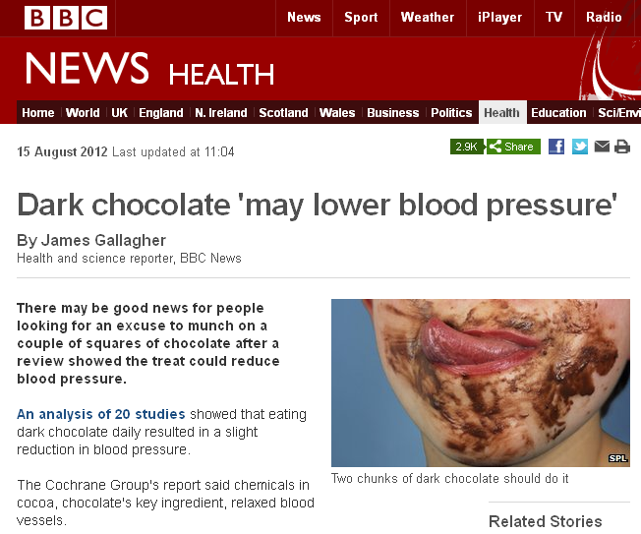

Slide 11
PICO
Patient / Population / Problem | Intervention / Exposure | Comparison | Outcome
Hypertension Blood pressure | Cocoa Chocolate Flavanoid* | N/A | Reduce Reducing Reduction Lower Lowering

Slide 12
Why do this?
Get people to think of searching as related to patient care
Make searching relevant to day to day work
Less threatening than starting off asking people to think of their own questions

Slide 13
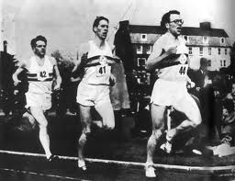
Search off

Slide 14
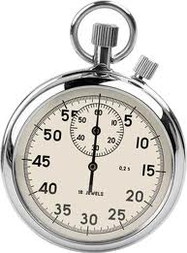

Slide 15
UpToDate (Sub) http://www.uptodate.com
TRIP http://www.tripdatabase.com
PubMed Clinical Queries http://www.pubmed.gov
Cochrane Library http://www.thecochranelibrary.com
Google http://www.google.co.uk
GoogleScholar http://scholar.google.co.uk
Wikipedia http://en.wikipedia.org
NHS Evidence http://www.evidence.nhs.uk
Clinical Evidence (Sub) http://clinicalevidence.bmj.com/x/index.html
EBM Journal (Sub) http://ebm.bmj.com/

Slide 16
Why run a search off?
Get people out of the habit of using only 1 or 2 resources
Opportunity to discuss pros / cons of different resources
Introduce participants to point of care search tools e.g. research synopses & evidence syntheses

Slide 17
Teach yourself PubMed
Finding the Evidence videos
http://www.cebm.net/index.aspx?o=1038
PubMed tutorials
  Full tutorial
  Quick tours for individual tasks
  http://www.nlm.nih.gov/bsd/disted/pubmed.html

Slide 18
Why do this?
Allows you to teach a mixed group using a blended learning approach
Ideal for distance learning
Self-paced learning allows participants to focus on what they want to know
Introduce participants to resources they can use after the session to help them with searching

Slide 19
Useful sources: Clinical scenarios
News stories:
  Medical News Today http://www.medicalnewstoday.com/
  Behind the headlines http://www.nhs.uk/News/Pages/NewsIndex.aspx
  Blitter http://blitter.tripdatabase.com/
  National / local news web-sites
Video clips:
  Embarrassing bodies http://www.channel4embarrassingillnesses.com/
  healthtalkonline http://www.healthtalkonline.org/
  Ehow health http://www.ehow.com/ehow-health/
  Youtube http://www.youtube.com/

Slide 20
Useful sources: searching
Cochrane Library www.cochrane.org
Global health library www.globalhealthlibrary.net
PubMed www.pubmed.gov
TRIP www.tripdatabase.com
HLWIKI Point of care decision making tools
http://hlwiki.slais.ubc.ca/index.php/Point_of_care_decision-making_tools_-_Overview

